Slide 1
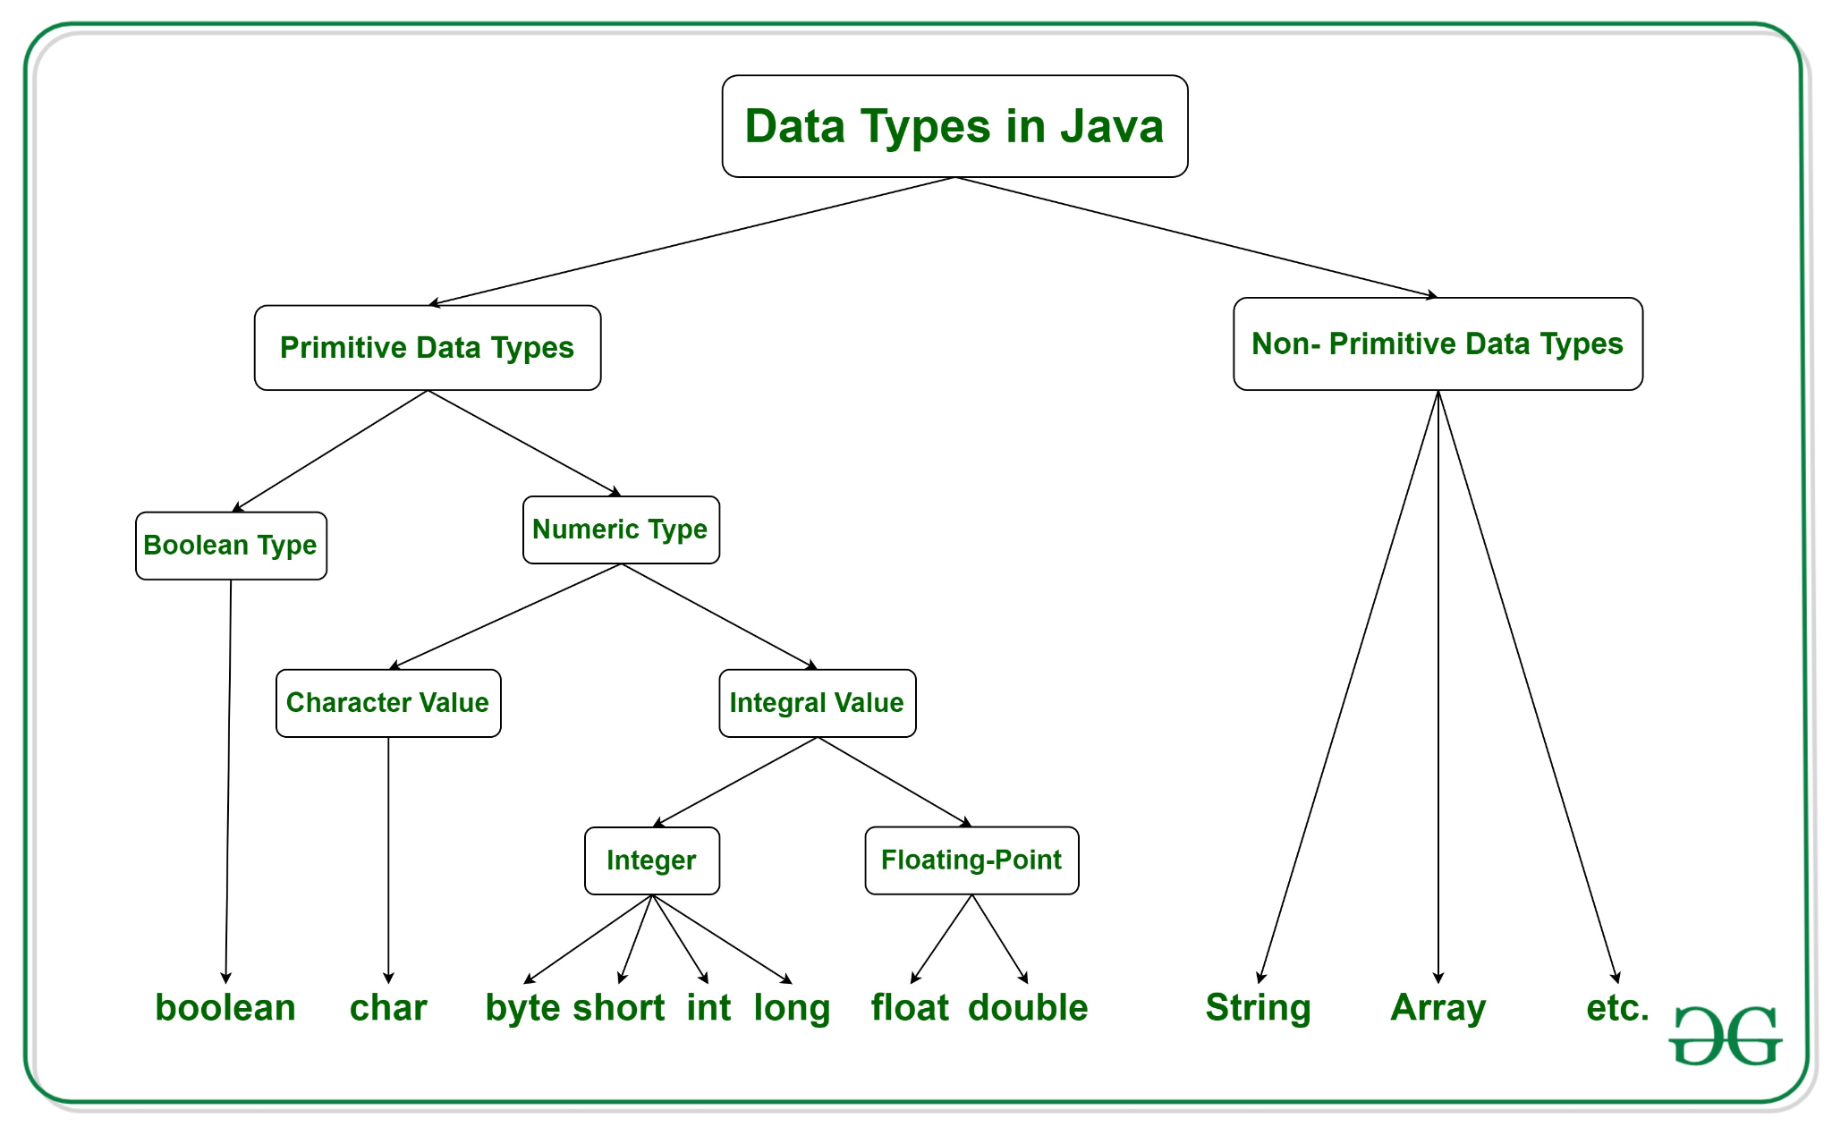
M01 L03 Conversion between Primitive Data Types

Slide 2

Goals
Check in - any questions?
Primitive Data Type, Memory and Conversion
Explain how memory is allocated for variables based on data types.
Compare and contrast variables, constants and literals
Recognize domains of data types and potential overflow errors
Discover and describe implicit and explicit conversion rules in assignment statements
Describe cast operator and apply in code
Explore mixed integer operations
Technical Documentation
Describe and explain benefits of technical developer documentation

Slide 3

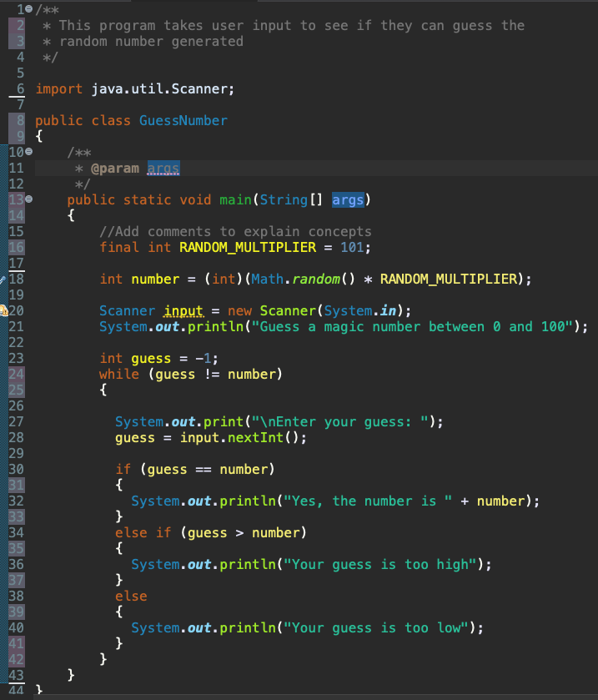

Java Program Chat
Give example from the code and brief understanding
Data type
Declaring and initializing a variable
Variable
Constant
Assignment operator
Identifier
literal
method
Class
Keyword
comment
Give example not in code and brief understanding
Data type
Declare variable but do not initialize
Example of allocating memory

Slide 4

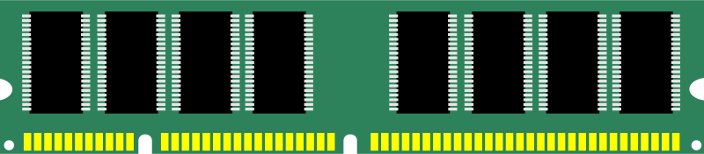
Memory Concepts
What happens when you declare a variable?
How do you read these statements?
final double PI = 3.14
009AFD2A
How is the amount of memory to be allocated determined?
How is memory allocated for a constant different than a variable?
int radius = 4
009AFD30
How is the memory accessed?
double area = radius * radius * PI;
009AFD3C

Slide 5
Memory Concepts
Memory is allocated to a location with a unique address to store that variable’s value.
Data type identifier assign initial value
Declaring a constant (final) allocated enough memory for the data type in read only memory
final double PI = 3.14
009AFD2A
Declaring variables allocated enough memory for the data type in read/write memory
int radius = 4
009AFD30
Access the memory address through the identifier (variable or constant name ).
double area = radius * radius * PI;
009AFD3C

Slide 6
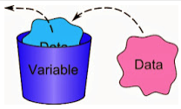
Cup Analogy
Each data type has a range of values that are valid for that type
Declaring a variable a certain type sets aside (allocates) a certain amount of memory for that variable
Think of a Variable as a Cup
Cup is a container -> Variable is a container
Cup holds something -> Variable holds a value
Cup has a size -> Variable has a size
Variable has a name

Slide 7
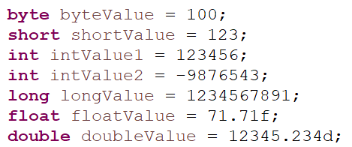
Analyze Code
Describe in terms of declaring, initializing assigning, memory and literals
What do you think about these assignment statements?
floatValue = intValue1;
intValue2 = doubleValue;

Slide 8
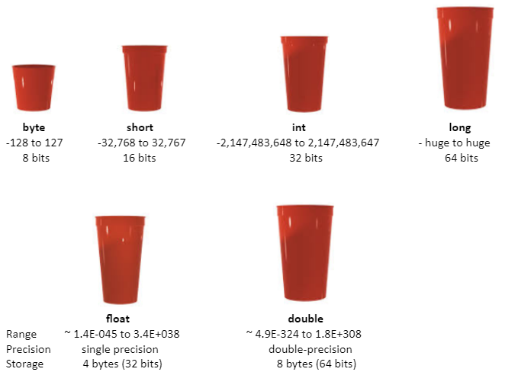
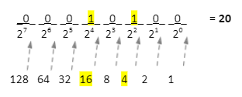
Primitive Data Types
Bits and bytes
1 byte is made up of 8 bits
This shows one byte whose value is 20

Slide 9
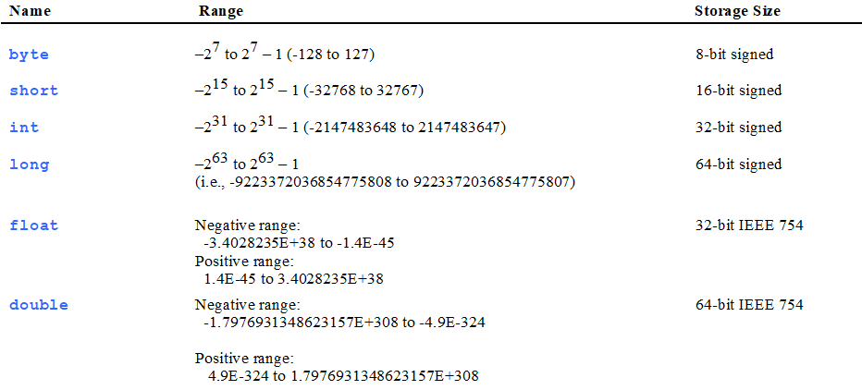
Data Type Ranges and Storage Size

Slide 10
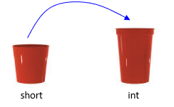

Rules
When declaring variables - be sure it’s potential values can fit into the type you assign (i.e. cup)
Pick the best type for your variable, although, if there are no concerns about memory
int – generally used as default type for integral values
double – generally used as default type for decimal values
You can put the contents of a smaller variable (cup) into a larger variable (cup)

Slide 11
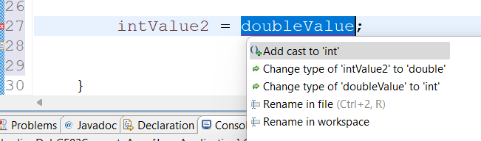
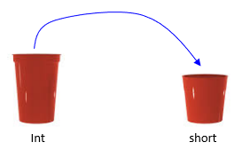
Error
You cannot put the contents from a larger variable (cup) into a smaller variable (cup)
Well you can but you must do something special to do so
You will also lose information when you do this
Causes compiler error: cannot convert from int to byte

Slide 12
Review
You can put the contents of a smaller variable (cup) into a larger variable (cup)
byte smallCup = 5;
int bigCup = 10;
// The bigger cup can take on what’s in smaller cup
bigCup = smallCup;
// This causes error can’t put what’s in a larger cup into a smaller cup!
smallCup = bigCup;
You cannot put the contents from a larger variable (cup) into a smaller variable (cup) unless you do something special - casting

Slide 13
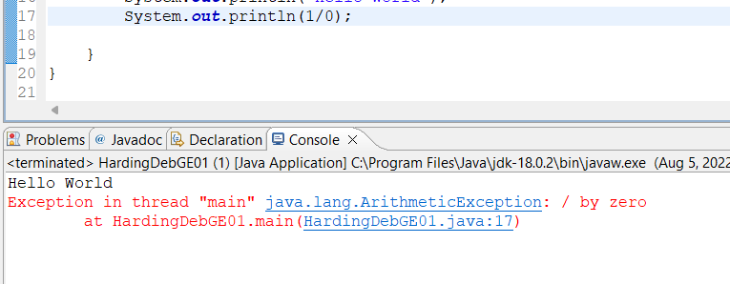
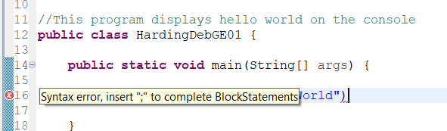
Types of Errors
SyntaxErrors
RuntimeErrors
LogicErrors - Test to see if result is correct. Celsius to Fahrenheit conversion : ºC to ºF calculator. What is the problem? How can it be fixed?

Slide 14
Division Should Produce Double
How can this be fixed to produce a decimal value from the division? Try each of the following.
public class ShowLogicErrors {
public static void main(String[] args) {
System.out.print("Celsius 35 is Fahrenheit degree ");
System.out.println((double)(9 / 5) * 35 + 32);
}
}
What did you discover? What do you think is happening?
public class ShowLogicErrors {
public static void main(String[] args) {
System.out.print("Celsius 35 is Fahrenheit degree ");
System.out.println(((double)9 / 5) * 35 + 32);
}
}

Slide 15
Type Casting
You cannot put the contents from a larger variable (cup) into a smaller variable (cup) unless you do something special - casting
Casting is an operation that converts one data type to another. Casting widens or narrows the type. Read Type Casting in Java - Javatpoint
To convert a variable of one type into another type: (type)value
Widening
Casting a value with a smaller range to one with a bigger range
Java does this automatically because safe to do
Example double d = 3;
Narrowing
Casting a value with a bigger range to one with a smaller range
You must do explicitly because it can result in losing data
Example int number = (int)3.0;
implicit casting
explicit casting

Slide 16
Numeric Type Conversions
The smaller type is converted to a larger type before operation occurs.
When performing a binary operation involving two operands of different types, Java automatically converts the operand based on the following rules:
1. If one of the operands is double, the other is converted into double.
2. Otherwise, if one of the operands is float, the other is converted into float.
3. Otherwise, if one of the operands is long, the other is converted into long.
4. Otherwise, both operands are converted into int/short/byte accordingly.

Slide 17
Numeric Type Conversion Examples
What is the difference between using the 3 literal and the 2.0 literal? What is the data type of each?
public class Test1 {
public static void main (String[] args) {
System.out.println("3 / 2 = " + (3 / 2));
System.out.println("3 / 2.0 = " + (3 / 2.0));
System.out.println("3.0 / 2 = " + (3.0 / 2));
System.out.println("3.0 / 2.0 = " + (3.0 / 2.0));
}
}
Explain the conversions that are done for the mixed type operations.
Output
3 / 2 = 1
3 / 2.0 = 1.5
3.0 / 2 = 1.5
3.0 / 2.0 = 1.5

Slide 18
Integer Overflow
You assign a variable a certain data type which means it is a certain size
Then if you place a value into that variable that is too big it will "overflow"
This is like pouring the liquid of a big cup into a small cup - it "overflows"
Java will not tell you about this issue!!! You will instead get weird numbers!
int bigCup = 128;
// Cast the int into a byte
byte smallCup = (byte)bigCup;
// Overflow occurred!
System.out.println (smallCup);
int overflowInteger;
int goodInteger = 2147483647;
overflowInteger = ++goodInteger;
System.out.println("Overflow Integer = " + overflowInteger);
Displays:
Overflow Integer: -2147483648
What is an Integer Overflow Attack (with Examples)?

Slide 19
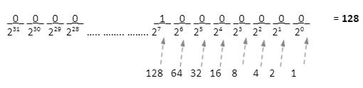
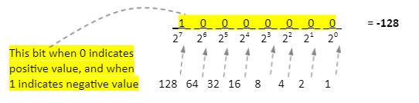

Integer Overflow
An int is 32 bits long. When 128 is assigned to an int there is plenty of room for 128
A byte is 8 bits. When 128 is assigned to a byte it is too big and overflow is caused and it becomes -128.

Slide 20
Pair Programming
How do you create a new class? How is your information organized?
Pair Programming: consists of two programmers sharing a single workstation where both programmers are actively engaging
What happens in memory when declaring a constant or a variable.
public class ShowLogicErrors
{
public static void main(String[] args) {
final int TOTAL_QUIZZES = 3;
int quiz1 = 9;
int quiz2 = 10;
int quiz3 = 7;
double average = (quiz1 + quiz2 + quiz3)/TOTAL_QUIZZES;
System.out.println("average: " + average);
}
}
What happens when you divide to integers?
What is another way to fix this? Explain using concepts from class.
What is one way to fix this logic error?
Explain using concepts from class.

Slide 21
Remember
Variables must be assigned a value before they are used.
Java does not initialize variables automatically.
Clean up warnings
Don’t leave unused variables in your code.
Dividing two integers
Result is an integer!
If there is a fractional part, it is truncated!
If need fractional part when dividing 2 integers - cast or make one of the integers a double

Slide 22
Preparation: Lab and Guided Exploration
Go to Canvas Module L02 and look at the preparation
Open participation class scavenger hunt and complete with your team
Work on GE01 sec 3.1

